Slide 1
Digital Portfolio
STUDENT NAME: KANISHKA S
REGISTER NO AND NMID: asbru3j24121056
DEPARTMENT: BSC.COMPUTER SCIENCE
COLLEGE: TIRUPPUR KUMARAN COLLEGE FOR WOMEN/BHARATHIYAR UNIVERSITY

Slide 2
PROJECT TITLE
SINGER PORTFOLIO

Slide 3


AGENDA
Problem Statement
Project Overview
End Users
Tools and Technologies
Portfolio design and Layout
Features and Functionality
Results and Screenshots
Conclusion
Github Link
3/21/2024 Annual Review

Slide 4

PROBLEM STATEMENT
In today’s digital age, it is crucial for artists, especially singers, to establish a strong online presence to reach wider audiences, showcase their talent, and attract professional opportunities. However, many talented singers struggle to effectively promote themselves due to a lack of centralized, professional, and aesthetically appealing platforms that highlight their work, achievements, and unique style.

Slide 5

PROJECT OVERVIEW
The Singer Portfolio project aims to design and develop a personalized, professional, and visually engaging online platform for a singer to showcase their talent, work, and career milestones. The portfolio will serve as a digital identity and promotional tool, helping the singer build a strong online presence and connect with fans, music producers, event organizers, and collaborators.

Slide 6

WHO ARE THE END USERS?
A singer portfolio is designed to serve multiple types of end users, each with specific interests and goals when visiting the portfolio. Here’s a breakdown of the key end users: 1. Music Industry Professionals
2. Fans and Followers
3. Collaborators and Other Artists
4. Media & Press
5. Event Planners & Venue Owners

Slide 7

TOOLS AND TECHNIQUES
1. Design & Prototyping Tools
2. Web Development Tools
3. Hosting & Deployment Platforms
4. Media Integration Platforms
5. Analytics & SEO Tools

Slide 8
POTFOLIO DESIGN AND LAYOUT
The design should reflect the singer's brand, genre, and personality—whether elegant, edgy, vibrant, minimalist, or artistic. It must also be mobile-responsive, easy to navigate, and visually engaging.
1. Homepage (Landing Page)
2. About / Biography Page
3. Music / Audio Page
4. Videos / Performances Page
5. Gallery (Photos)
8

Slide 9
FEATURES AND FUNCTIONALITY
Here is a comprehensive list of Features and Functionality for a professional Singer Portfolio—ideal for a website, web app, or digital showcase.
1. Homepage
2. About / Bio Page
3. Music Section
4. Video Gallery
5. Photo Gallery

Slide 10
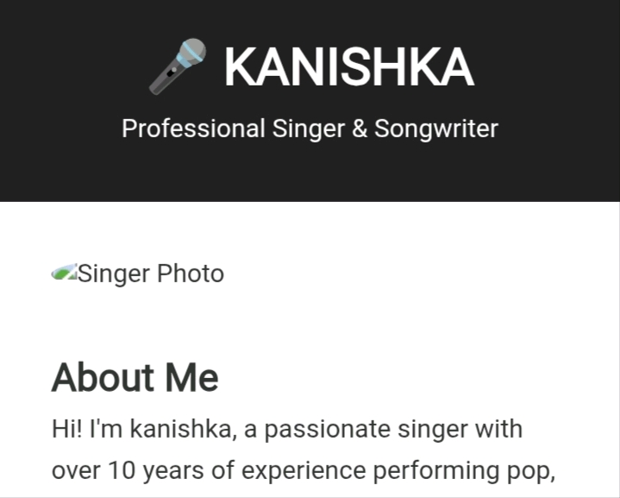

RESULTS AND SCREENSHOTS
3/21/2024 Annual Review
10

Slide 11
CONCLUSION
Music has always been more than a passion—it's my way of connecting with people, telling stories, and expressing the moments words alone can’t capture. Through each performance and collaboration, I strive to grow as an artist and contribute meaningfully to the world of music
11

